Slide 1
Team GroupBy Toyosi Bamidele , Uchenna Mgbaja

Slide 2
Outline
Problem
Solution
Data + Model
Demo
MLE Stack
Conclusions (and lessons learned)
Future Work

Slide 3
Problem
Understanding customer behavior in the e-commerce space, a business area altered during the pandemic due to increased demand for online purchases, improving the customer experience, to ensure customer retention and product monetization is critical. The main goal is optimizing the customer journey and shopping experience using a predictive model and recommendation system

Slide 4
Solution
1.Predictive Model:Uplift model(One and Two model approach)
What customers are likely to convert?
Who should we target primarily?
2.Recommendation System
What products should we recommend to our users based on their purchase history?
What products should we recommend to users based on items pairs from past basket purchases

Slide 5
Uplift modeling
Uplift models helps in identifying users that are more likely to take action or respond positively after treatment exposure like a marketing campaign or promotional offer

Slide 6




Classic Uplift Segments
Persuadables
Sure things
Jane will take action if treated
Lily will always take action
Sleeping Dogs
Lost Causes
Treating James will cause adverse effects
Stan will never take action
Notes:
The ‘sure things’ and ‘lost causes’ both have zero uplift, because their target and control conversion rates are the same (100% for ‘sure things’, and 0% for ‘lost causes’). There is no benefit in applying treatment to these customers. For ‘persuadables’, however, there is 100% uplift, because the treatment conversion rate is 100%, while the control conversion rate is 0%. These are the customers that should be targeted for treatment. Conversely, the ‘sleeping dogs’ have a -100% uplift, which means that targeting these customers for treatment will drive them away from buying. These customers should not be contacted.

Slide 7
Classic Uplift Segments
Persuadables
Sure things
The goal is to find “Jane”
Jane will take action if treated
Lily will always take action
Sleeping Dogs
Lost Causes
Exempt “Lily”, “James”, and “Stan” from treatment
Treating James will cause adverse effects
Stan will never take action

Slide 8
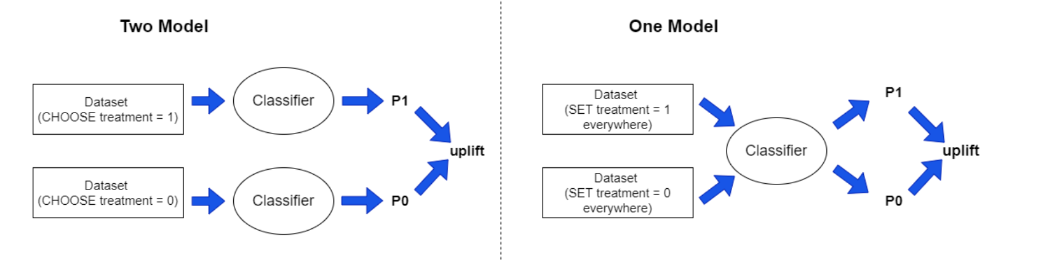
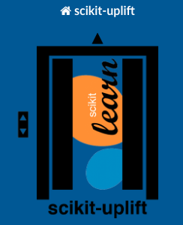
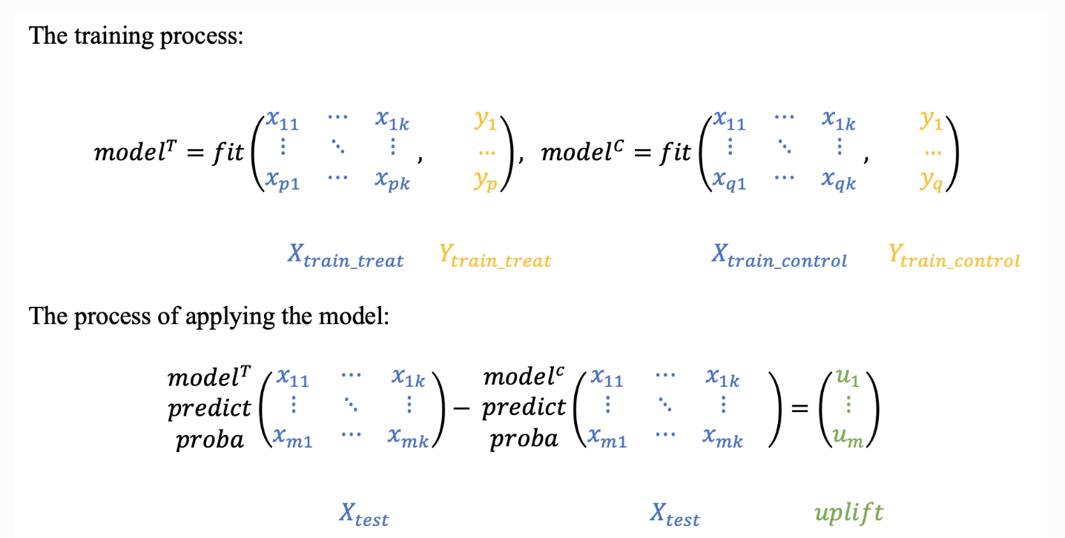
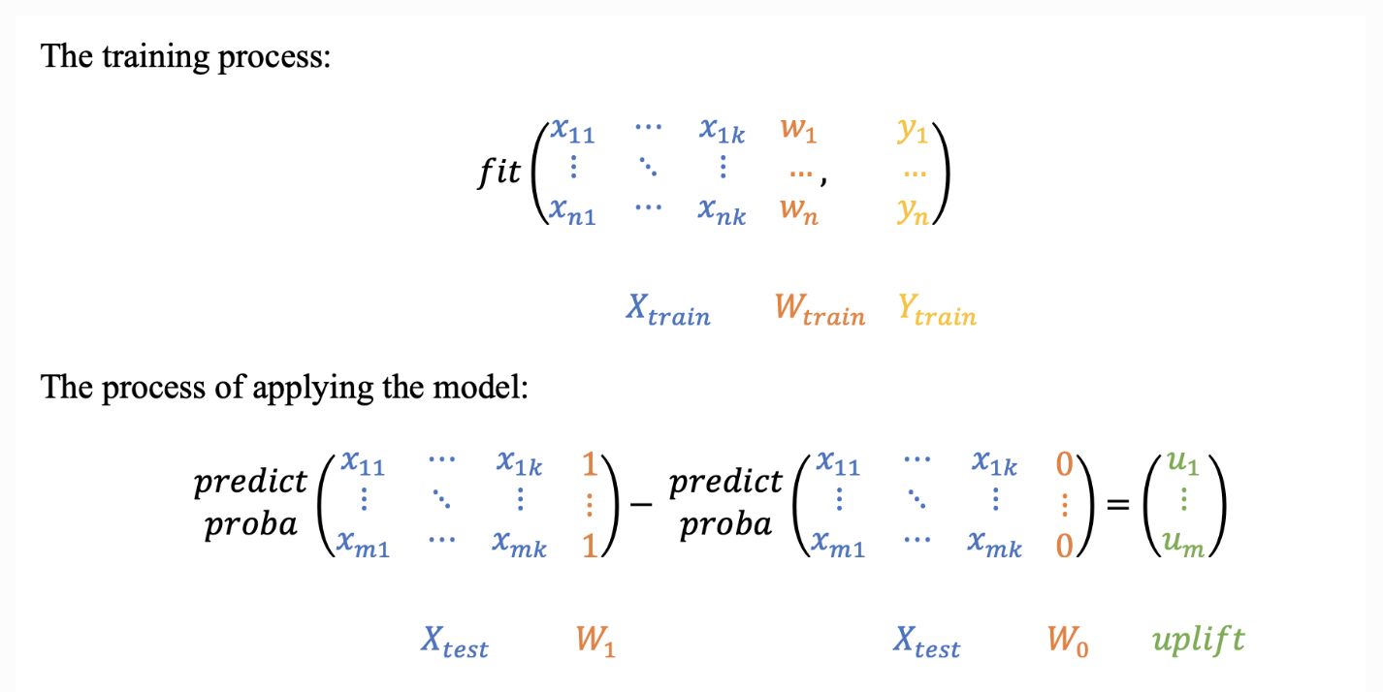
Uplift Model
Notes:
https://www.uplift-modeling.com/en/latest/user_guide/models/index.html
https://pbiecek.github.io/xai_stories/story-meps-explainable-predictions-for-healthcare-expenditures.html
Models
Decision Tree, Logistic Regression, Random Forest:, XG Boost
Process
One Model
The most intuitive and simple uplift modeling technique. A training set consists of two groups: treatment samples and control samples. There is also a binary treatment flag added as a feature to the training set. After the model is trained, at the scoring time it is going to be applied twice: with the treatment flag equals 1 and with the treatment flag equals 0. Subtracting these model’s outcomes for each test sample, we will get an estimate of the uplift.
Two Model
The main idea is to estimate the conditional probabilities of the treatment and control groups separately.
Train the first model using the treatment set.
Train the second model using the control set.
Inference: subtract the control model scores from the treatment model scores.

Slide 9
Implementation
Example features that can be used to predict conversion rate
Traffic sources, Device usage, User behavior, Customer segments
A/B testing/ Multivariate testing
Dataset provided not ideal for uplift modeling
New Dataset includes an “offer” feature (Offer: BOGO, Discount)
Notes:
Specify what Success looks like, and for what Audience.

Slide 10
Data + Model (1 min)
Uplift model ( Single Model, 2- model, 4-quadrant, Pylift- T-learner, Causal ML- R Learner, Causal ML- X Learner)
ML Model ( XGBoost Classifier)
Evaluation metric: Qini Coefficient (Treatment effect between 0-1)
Notes:
Any unique data wrangling/data-centric AI? If not, leave out. Lineage?
Pre-trained model? If not, why not? Fine-tuned? If not, why not?
Messy live data, modeling explainability aspects, ethical/responsible?
Choose wisely; time is of the essence; four bullets always better than five.
● Public dataset: Provided in Capstone
○ Kaggle E-Commerce events history in cosmetics shop data set
○ Online Retail Data set
Additional Datasets: Similar Datset that includes ‘boosted campaign’ feature
● https://www.kaggle.com/competitions/conversion-rate-prediction/data?select=train.csv

Slide 11
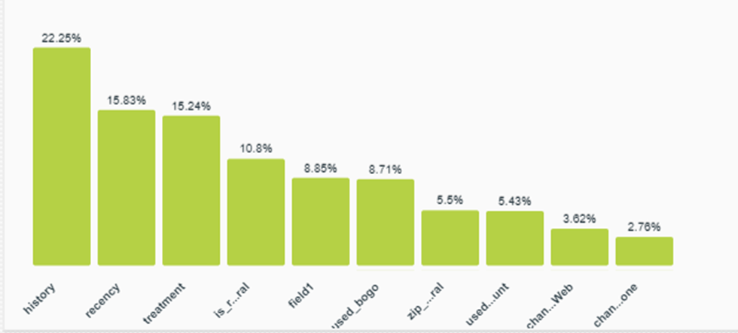
Feature Importance
Notes:
Any unique data wrangling/data-centric AI? If not, leave out. Lineage?
Pre-trained model? If not, why not? Fine-tuned? If not, why not?
Messy live data, modeling explainability aspects, ethical/responsible?
Choose wisely; time is of the essence; four bullets always better than five.
● Public dataset: Provided in Capstone
Kaggle E-Commerce events history in cosmetics shop data set
○ Online Retail Data set
Additional Datasets: Similar Datset that includes ‘boosted campaign’ feature
● https://www.kaggle.com/competitions/conversion-rate-prediction/data?select=train.csv

Slide 12
Demo
Base Model
Bogo Model
Discount Model

Slide 13
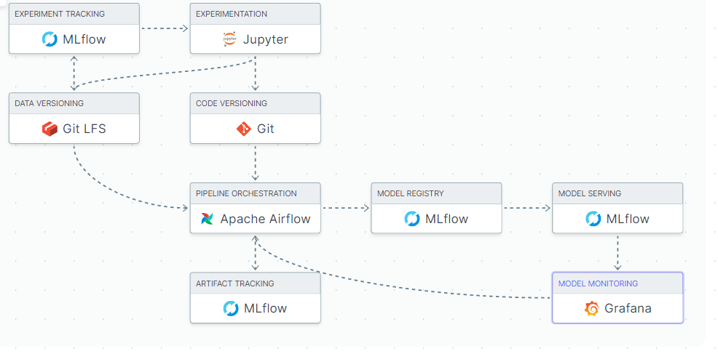
MLE Stack
Add your stack image here!

Slide 14
Conclusions & Future Work
Optimize Uplift Model
Recommendation System
MLE Stack Optimization
Notes:
This is where you can tell funny stories about the stupid things you did!
This is also the slide where you might convey the difference between what you set out out to do, and what you actually did.

Slide 15
Thank You! Questions?

Slide 16
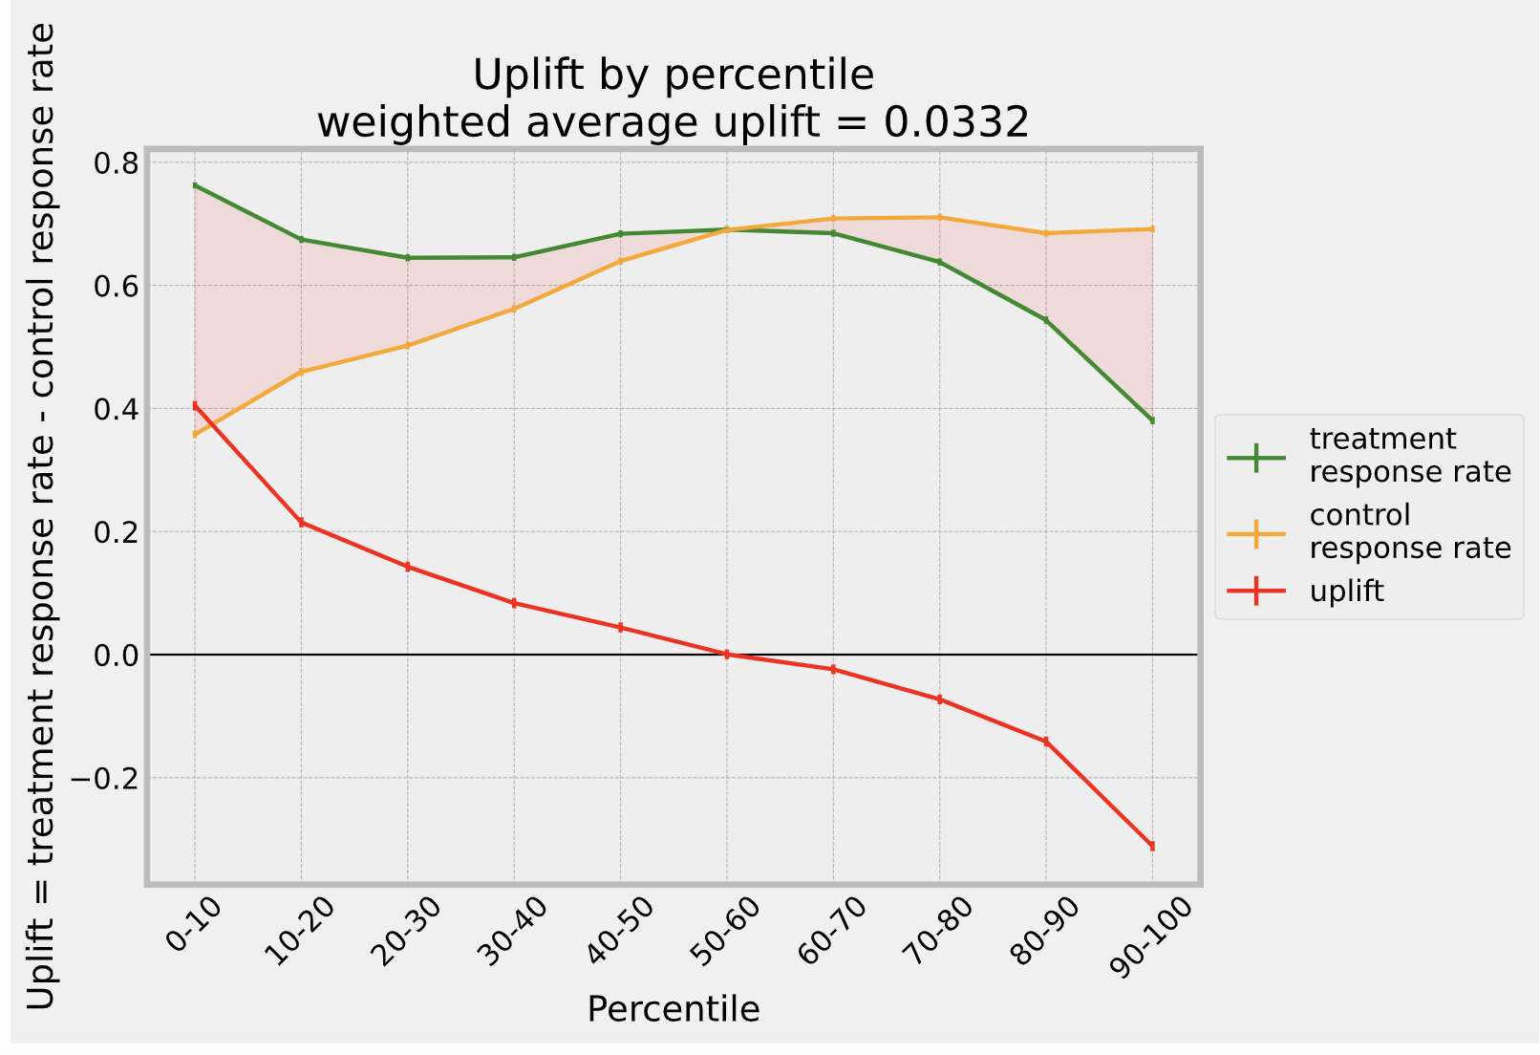
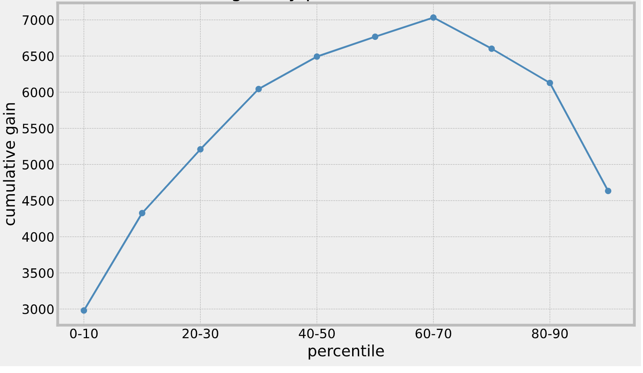
Uplift model:
positive uplift - persuadables
0 - lost causes and sure things
negative uplift - sleeping dogs
Hypothetical
Notes:
https://juanitorduz.github.io/uplift/

Slide 17
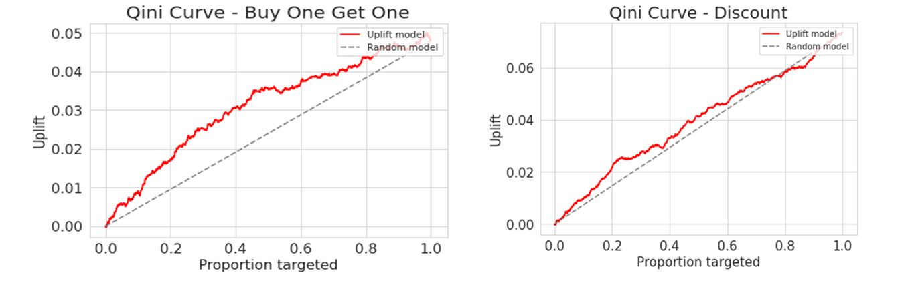
Uplift model
Notes:
https://juanitorduz.github.io/uplift/

Slide 18
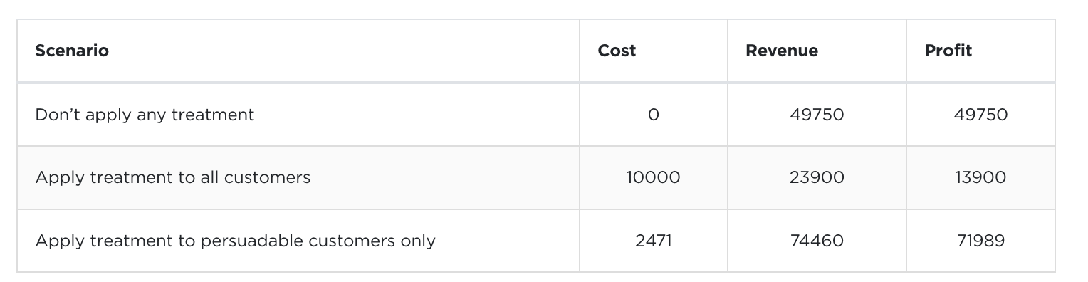
Success Criteria
Hypothetical

Slide 19
